Slide 1
Supported Decision Making

Slide 2
For Your Information
Any Content, whether provided by Disability Rights Florida or its Presenters, is presented for educational, general reference and informational purposes only; is not intended to serve as legal or other advice; is not intended to be a full and exhaustive explanation of the law in any area; should not be used to replace the advice of your own legal counsel; and Disability Rights Florida makes no representation or warranty that the Content is accurate, complete or current for any specific or particular purpose or application.

Slide 3
For Your Information (continued)
Participants of this presentation should contact their attorney to obtain advice with respect to any particular legal matter. No reader, user, or browser of this presentation should act or refrain from acting on the basis of information on this site without first seeking legal advice from counsel in the relevant jurisdiction. Only your individual attorney can provide assurances that the information contained herein – and your interpretation of it – is applicable or appropriate to your particular situation. Use of, and access to, this presentation or any of the links or resources contained within the presentation do not create an attorney-client relationship between the reader, user, or browser and website authors, contributors, contributing law firms, or committee members and their respective employers

Slide 4
Objectives
Define the less restrictive alternative to guardianship known as SDM.
Describe how SDM works and how it can incorporate other alternatives to guardianship such as Powers of Attorney and Health Care Surrogate Designations.
List three elements that are typically found in a SDM Agreement.
Recognize the importance of preserving decision-making rights and promoting self-determination and autonomy when working with clients who are older adults or have a disability.

Slide 5
Speaker
Z. Felicia Jordan, Director of the Social Security Representative Payee Program, Disability Rights Florida

Slide 6
Transition Services
Education

Slide 7
I was told that I needed a Guardianship to continue education services after age 18. #1
According to IDEA, once a young adult turns 18 years old, “All rights accorded to parents under Part B of the Act transfer to the child”. (34 C.F.R. §300.520(a)(1)(ii).
Florida Administrative Code, Rule 6A-6.03311(8)(e) notes;
“(e) If a student with a disability has reached the age of majority and does not have the ability to provide informed consent with respect to his or her educational program, procedures established by statute may be used by the parent to:

Slide 8
I was told that I needed a Guardianship to continue education services after age 18. #2
1. Have the student declared incompetent and the appropriate guardianship established in accordance with the provisions of Chapter 744, F.S.;
2. Be appointed to represent the educational interests of their student throughout the student's eligibility for FAPE under Rules 6A-6.03011 through 6A-6.0361, F.A.C.; or
3. Have another appropriate individual appointed to represent the educational interests of the student throughout the student's eligibility for FAPE under Rules 6A-6.03011 through 6A-6.0361, F.A.C., if the parent is not available in accordance with Section 393.12, F.S.”
Notes:
Rule Alert – This rule is under current development with a workshop on June 5, 2023 at 2:00 p.m.

Slide 9
Guardianship

Slide 10

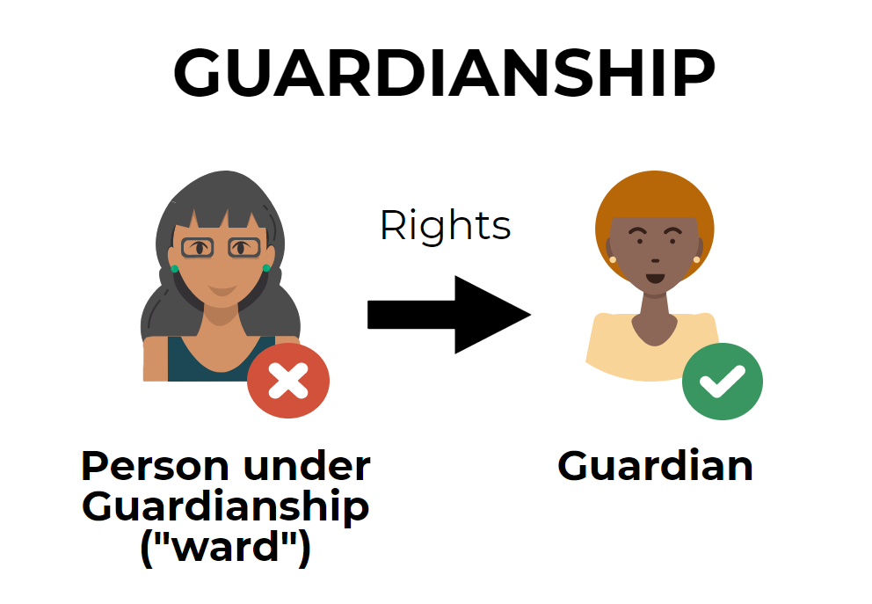

What is Guardianship?
Notes:
Viviana
Poll 2: Have you ever litigated a guardianship case?
Option 1: Yes
Option 2: No

Slide 11
What is Guardianship? Cont’d
If a court finds that a person does not have the ability to safely manage the things that belong to them and/or meet their basic health, safety, and self-care needs, the court will rule that this person is incapacitated. In many cases, after a court decides that a person is incapacitated, they will choose someone else to make some or all the decisions for the incapacitated person. This is called a guardianship.

Slide 12
Types of Guardianship
Natural Guardians
Full (Plenary) Guardianship
Guardian Advocacy for Individuals receiving Mental Health Treatment
Guardian Advocacy for Individuals who have a Developmental Disability.
There are other types of guardianship under Florida Statue, but we will limit the list for this presentation

Slide 13
Natural Guardians
According to Florida Statute, Chapter 744.301(1), natural guardians are;
“The parents jointly are the natural guardians of their own children and of their adopted children, during minority, unless the parents’ parental rights have been terminated pursuant to chapter 39. If a child is the subject of any proceeding under chapter 39, the parents may act as natural guardians under this section unless the court division with jurisdiction over guardianship matters finds that it is not in the child’s best interests…The mother of a child born out of wedlock is the natural guardian of the child and is entitled to primary residential care and custody of the child unless the court enters an order stating otherwise.”

Slide 14
Full Guardianship
When the court finds that an individual is unable to perform all of the tasks necessary to care for his or her person or property, the court will rule that the individual is totally incapacitated. This is known as a full or plenary guardianship. This is the most restrictive type of guardianship and few people require this type of guardianship.

Slide 15
Guardians Can…
Contract
Sue and defend lawsuits
Apply for government benefits
Manage property or to make any gift or disposition of property
Determine ward’s residence
Consent to medical and mental health treatment
Make decisions about ward’s social environment or other social aspects of his or her life

Slide 16
Rights That Can Be taken Away Under 744
To marry. If the right to enter into a contract has been removed, the right to marry is subject to court approval
To vote
To personally apply for government benefits
To have a driver’s license
To travel
To seek or retain employment

Slide 17
Legal Rights that can NEVER be Taken Away
There are rights that are fundamental freedoms and privileges that are protected as civil rights. The followings Civil Rights cannot be taken away from adult:
Right to Represented by counsel (Attorney)
Right to have access to court(s)
Right to have a proper education
Right to be free from abuse, neglect or exploitation
Right to receive necessary services and rehabilitation
Right to be treated humanely, with dignity and respect

Slide 18
Need Court Authority
Commit ward to a facility, institution, or licensed service provider without formal placement proceeding, under chapters 393, 394, or 397.
Consent to the performance on the ward of any experimental biomedical or behavioral procedure or to the participation by the ward in any biomedical or behavioral experiment.
Initiate a petition for dissolution of marriage for the ward.
Consent on behalf of the ward to termination of the ward’s parental rights.
Consent on behalf of the ward to the performance of a sterilization or abortion procedure on the ward.
Consent to change the ward’s residence from one county residence to another.

Slide 19
Guardians must…
Pass criminal and credit check
Have an attorney
Take 8 hour training course (non-professional)

Slide 20
Guardian Advocacy

Slide 21
Guardian Advocate for Individuals receiving Mental Health Treatment
According Florida Statute, Chapter 394.4598;
The administrator of a facility may petitioner the court for the appointment of a guardian advocate upon the opinion of a psychiatrist that the patient is incompetent to consent to treatment. If the court finds that a patient is incompetent to consent to treatment and does not already have a guardian with the authority to consent to mental health treatment in place, the court shall appoint a guardian advocate. A person who is appointed as a guardian advocate must agree to the appointment.

Slide 22
Guardian Advocate for Individuals who have a Developmentally Disability - 1 of 2
According to Florida Statute, Chapter 393.12;
A person who has a developmental disability can be placed in a guardianship under a guardian advocate even when a court has not determined them to be incapacitated. A person has a developmental disability if they have been diagnosed with an intellectual disability, cerebral palsy, autism, spina bifida, Down syndrome, Phelan-McDermid syndrome, or Prader-Willi syndrome. Only the specific rights in which a person cannot manage are removed. The court may look at the individual’s support plan, their Individual Education Plan, and/or other supporting documents to determine the level of disability and need for assistance.

Slide 23
Guardian Advocate for Individuals who have a Developmentally Disability - 2 of 2
The common areas that guardian advocates assist individuals with include:
Giving informed consent for medical procedures and mental health treatment,
Managing money and/or property,
Applying for governmental benefits or entitlements; and
Deciding on residential choices.
Florida law requires that guardians and guardian advocates consider the ward’s wishes and allow the ward to participate in decisions affecting the ward’s life. Furthermore, Florida law places a duty upon guardians to notify the court if the guardian believes that the ward has regained capacity and/or if one or more of the rights that have been removed should be restored to the ward.

Slide 24
Guardian Advocacy – Developmental Disability (only)
Can be given the authority described above
No determination of incapacity
Less costly than Chapter 744 guardianship
Still is a form of guardianship
Less intrusive and less costly
Must lack the decision-making ability to perform some but not all tasks
Must have one of the seven statutorily- defined developmental disabilities

Slide 25
The Seven Statutorily-defined Developmental Disabilities
Intellectual Disability
Cerebral Palsy
Autism
Spina Bifida
Prader-Willi syndrome
Down Syndrome
Phelan McDermid syndrome
Notes:
Phelan McDermid Syndrome is also known as 22q13 deletion syndrome (spoken as twenty-two q one three[1]) is a genetic disorder caused by deletions or rearrangements on the q terminal end (long arm) of chromosome 22.

Slide 26
Guardianship Advocacy
Can be pursued without an attorney
Courts in many counties throughout Florida have forms that individuals can file without an attorney.
Guardianship Advocate training can be utilized online or in person training

Slide 27
Supported or Supportive Decision Making

Slide 28
Decision Making
It is a fundamental freedom to live as independently as possible.
However, with this freedom comes responsibilities to self, community and to society.

Slide 29
What is Supported Decision Making?
Supported Decision Making is a process that we all use to make choices in our lives. Everyone needs help making decisions every day. If someone we want services from used a specialized term for their business or procedure, it would be very hard to understand, almost like a foreign language. So, we ask for help from friends, family members, advocates and any other trusted person to help us understand. Once we get the information about what’s going on and what we need to do, we can make a good decision. This is supported decision making.

Slide 30
Why would one use Supported Decision Making?
We all have some trouble making decisions. You have the right to make choices. You can ask for support to make your decisions. This means that you will be making the decision, not someone making the decisions for you or instead of you. The person or persons that will support you are chosen by you. The supporters can help you make informed decisions in the following ways:
Collecting and communicating with you about information that is related to a decision
Helping you understand and explore your options
Explaining the risks and benefits of options
Giving guidance and recommendations
Assisting you in communicating and carrying out the decision

Slide 31
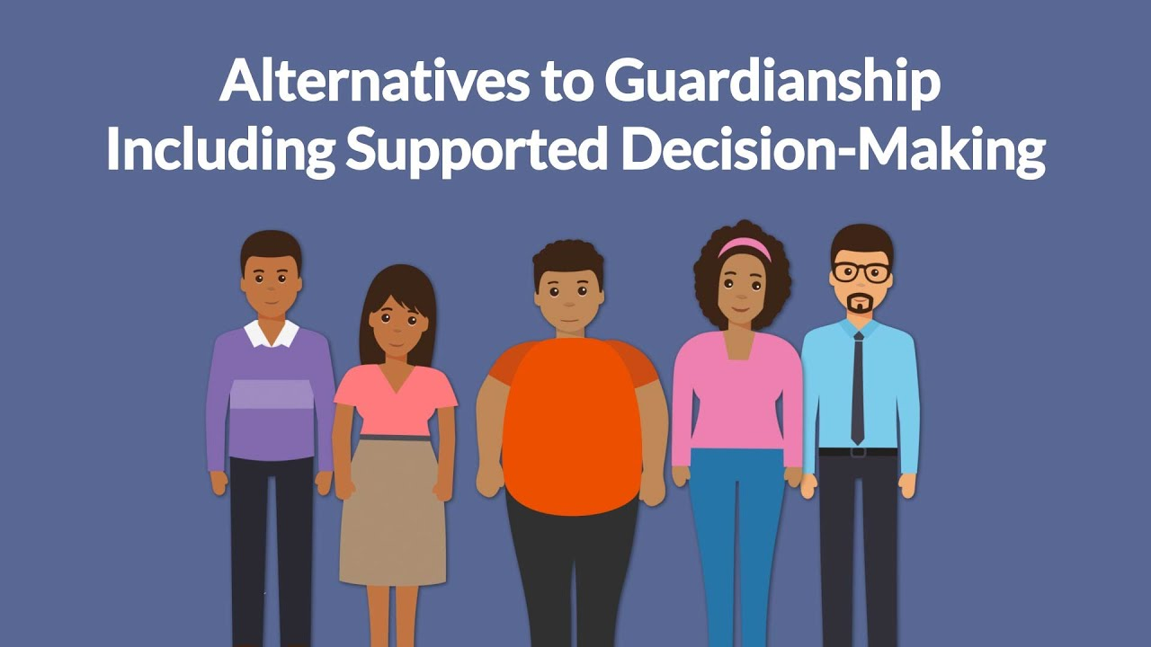
Supported Decision-Making
Supported decision-making is a process in which individuals with an intellectual or developmental disability are assisted in making decisions for themselves. Supported decision-making happens when an individual with intellectual or developmental disability is the decision maker, but is provided support from one or more persons who explain issues to the individual in a manner that he or she can understand. There is no one model of supported decision-making.

Slide 32
How does SDM factor into Florida Law?
744.1012 Legislative intent.—The Legislature finds that:
(1) Adjudicating a person totally incapacitated and in need of a guardian deprives such person of all her or his civil and legal rights and that such deprivation may be unnecessary.
(2) It is desirable to make available the least restrictive form of guardianship to assist persons who are only partially incapable of caring for their needs and that alternatives to guardianship and less restrictive means of assistance, including, but not limited to, guardian advocates, be explored before a plenary guardian is appointed. §744.1012, Fla. Stat. (2023).

Slide 33
Supported Decision Making in Florida
In Florida, at least one court has found that Supported Decision-Making agreements are a powerful alternative to guardianship. Self Advocate, Michael Lincoln with the help of Disability Rights Florida, was able to end his guardianship and enter a supported decision-making agreement that allowed him to keep all his rights. In re Guardianship of Michael Lincoln, Case No. 56 2014 GA 000041PPXXXX, slip op. at 4 (Fla St. Lucie Ct., 19th Cr. Ct. Oct. 13, 2016).

Slide 34
Principles Underlying Decision-Making
Self-Determination
Person-Centered Planning
Least restrictive alternative

Slide 35
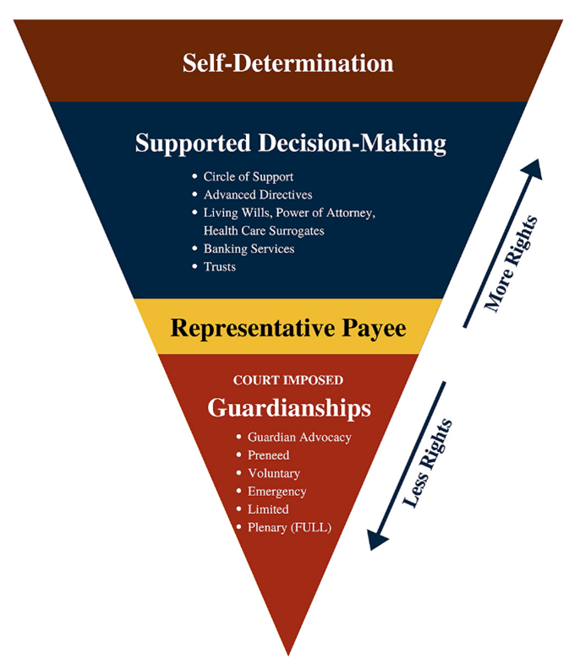
Levels of Adulting
Self-Determination
Support Decision-Making
Circle of Support
Advanced Directives
Living Wills, Power of Attorney, Health Care Surrogates,
Banking Services
Trusts
Representative Payee
Court Imposed Guardianships

Slide 36
Self-Determination (1 of 2)
Self-determination - The capacity to manage one's own affairs, makes one's own judgment and provide for oneself.
According to the National Parent Center on Transition and Employment, "Self determination is believing you can control your own destiny. Self-determination is a combination of attitudes and abilities that lead people to set goals for themselves, and to take that initiative to reach these goals. It is about being in charge but is not necessarily that same thing as self-sufficiency or independence. It means making your own choices, learning to effectively solve problem, and taking control and responsibility for one's life. Practicing self-determination also means one experience the consequences of making choice."

Slide 37
Self-Determination (2 of 2)
Greater control over one’s own life
Opportunities to make meaningful choices
Ability to choose from a variety of lifestyles, goals and preferences

Slide 38
Self Determination – Learning Activity
Jane is an 18-year-old woman who is deaf, mildly autistic and has a seizure disorder. Jane wants to move out of the family home and attend a local community college. Jane’s mother thinks Jane should move into a group home for young adults with developmental disabilities who need support services. Jane’s support coordinator agrees.
Jane is on the Agency for Persons with Disabilities waiver and receives Social Security Disability Insurance (SSDI). Jane’s mother is her representative payee. Jane asked her parents, support coordinator, and a high school guidance counselor with whom she remains friends to attend a meeting to make some decisions about what she should do next and how the funding and services she receives should be applied.

Slide 39
Self Determination – Learning Activity – Cont’d
The support coordinator gives Jane a list of group homes to choose from. Is this an example of self-determination?
Jane asks the support coordinator and her mother to help her prepare a budget and research the options available for on-campus housing. Is this an example of self-determination?

Slide 40
Person-Centered Planning – Cont’d
The person who the plan affects should be the one leading the planning process.
Person-centered planning is decisions driven by the person’s wants needs and financial abilities .
It is more respectful than decisions made for the person without their input.

Slide 41
Tools for Supported Decision Making

Slide 42
Health Care Surrogate and Living Wills
Can completed without an attorney
The creation of a Health Care Surrogate Form and/or a Living Will is a great opportunity to use the Supported Decision Process in assisting in making the Adult’s wishes known for Health Care needs or Advanced Directives.
Health Care Surrogate Form provides for someone to speak on their behalf in the event s/he are unable to.

Slide 43
Living Will
A Living Will is a legal document that expresses a person’s wishes regarding the providing, withholding, or withdrawal of life-prolonging procedures in the event of a terminal condition, an end-stage condition, or a persistent vegetative state.

Slide 44
Living Wills
Also known as an advanced directive, a proper living will would allow others to know your wishes for health care in the event of a terminal condition, an end stage condition or a persistent vegetative state.
Florida Statute 765.302 (1) provides for the procedure for making a living will as well as notice to physician;
Notes:
765.302 Procedure for making a living will; notice to physician.—
(1) Any competent adult may, at any time, make a living will or written declaration and direct the providing, withholding, or withdrawal of life-prolonging procedures in the event that such person has a terminal condition, has an end-stage condition, or is in a persistent vegetative state. A living will must be signed by the principal in the presence of two subscribing witnesses, one of whom is neither a spouse nor a blood relative of the principal. If the principal is physically unable to sign the living will, one of the witnesses must subscribe the principal’s signature in the principal’s presence and at the principal’s direction.
(2) It is the responsibility of the principal to provide for notification to her or his primary physician that the living will has been made. In the event the principal is physically or mentally incapacitated at the time the principal is admitted to a health care facility, any other person may notify the physician or health care facility of the existence of the living will. A primary physician or health care facility which is so notified shall promptly make the living will or a copy thereof a part of the principal’s medical records.
(3) A living will, executed pursuant to this section, establishes a rebuttable presumption of clear and convincing evidence of the principal’s wishes.

Slide 45
Living Wills - Forms
Florida Statute 765.303 provides a Suggested form of a living will. This would apply to adults only.
Notes:
765.302 Procedure for making a living will; notice to physician.—
(1) Any competent adult may, at any time, make a living will or written declaration and direct the providing, withholding, or withdrawal of life-prolonging procedures in the event that such person has a terminal condition, has an end-stage condition, or is in a persistent vegetative state. A living will must be signed by the principal in the presence of two subscribing witnesses, one of whom is neither a spouse nor a blood relative of the principal. If the principal is physically unable to sign the living will, one of the witnesses must subscribe the principal’s signature in the principal’s presence and at the principal’s direction.
(2) It is the responsibility of the principal to provide for notification to her or his primary physician that the living will has been made. In the event the principal is physically or mentally incapacitated at the time the principal is admitted to a health care facility, any other person may notify the physician or health care facility of the existence of the living will. A primary physician or health care facility which is so notified shall promptly make the living will or a copy thereof a part of the principal’s medical records.
(3) A living will, executed pursuant to this section, establishes a rebuttable presumption of clear and convincing evidence of the principal’s wishes.

Slide 46
Health Care Surrogate
A Health Care Surrogate is a legal document that gives permission to another person, known as the surrogate, to receive an individual’s health information and make health care decisions for that individual. The Health Care Surrogate serves as preparation in the event that the individual is no longer able to physically or mentally make informed health care decisions. The writing can provide for this authority to take effect immediately, or upon the legal determination of incapacity.

Slide 47
Health Care Surrogate Cont’d
The advantages of a Health Care Surrogate are;
Can completed without an attorney
The creation of a Health Care Surrogate Form and/or a Living Will is a great opportunity to use the Supported Decision Process in assisting in making the Adult’s wishes known for Health Care needs or Advanced Directives.
Health Care Surrogate Form provides for someone to speak on their behalf in the event s/he are unable to.

Slide 48
Health Care Surrogate – Legislative Intent
Florida Statute 765.102 — provides “that every competent adult has the fundamental right of self-determination regarding decisions pertaining to his or her own health, including the right to choose or refuse medical treatment.” The intent is establish a procedure that allows “a person to plan for incapacity by executing a document or orally designating another person to direct the course of his or her health care or receive his or her health information, or both, upon his or her incapacity.”
Notes:
Such procedure should be less expensive and less restrictive than guardianship and permit a previously incapacitated person to exercise his or her full right to make health care decisions as soon as the capacity to make such decisions has been regained.
The Legislature also recognizes that some competent adults may want to receive immediate assistance in making health care decisions or accessing health information, or both, without a determination of incapacity. The Legislature intends that a procedure be established to allow a person to designate a surrogate to make health care decisions or receive health information, or both, without the necessity for a determination of incapacity under this chapter.
(4) The Legislature recognizes that for some the administration of life-prolonging medical procedures may result in only a precarious and burdensome existence. In order to ensure that the rights and intentions of a person may be respected even after he or she is no longer able to participate actively in decisions concerning himself or herself, and to encourage communication among such patient, his or her family, and his or her physician, the Legislature declares that the laws of this state recognize the right of a competent adult to make an advance directive instructing his or her physician to provide, withhold, or withdraw life-prolonging procedures or to designate another to make the health care decision for him or her in the event that such person should become incapacitated and unable to personally direct his or her health care.

Slide 49
Health Care Surrogate – Health care facilities and providers; discipline
Florida Statute 765.110 Health care facilities and providers; discipline -
(1) A health care facility shall provide to each patient written information concerning the individual’s rights concerning advance directives and the health care facility’s policies respecting the implementation of such rights, and shall document in the patient’s medical records whether or not the individual has executed an advance directive.
(2) A health care provider or health care facility may not require a patient to execute an advance directive or to execute a new advance directive using the facility’s or provider’s forms. The patient’s advance directives shall travel with the patient as part of the patient’s medical record.
(3) A health care provider or health care facility shall be subject to professional discipline and revocation of license or certification, and a fine of not more than $1,000 per incident, or both, if the health care provider or health care facility, as a condition of treatment or admission, requires an individual to execute or waive an advance directive.
Notes:
Such procedure should be less expensive and less restrictive than guardianship and permit a previously incapacitated person to exercise his or her full right to make health care decisions as soon as the capacity to make such decisions has been regained.

Slide 50
Health Care Surrogate – Health care facilities and providers; discipline cont’d
Florida Statute 765.110 Health care facilities and providers; discipline.—
(3) A health care provider or health care facility shall be subject to professional discipline and revocation of license or certification, and a fine of not more than $1,000 per incident, or both, if the health care provider or health care facility, as a condition of treatment or admission, requires an individual to execute or waive an advance directive.
(4) The Department of Elderly Affairs for hospices and, in consultation with the Department of Elderly Affairs, the Department of Health for health care providers; the Agency for Health Care Administration for hospitals, nursing homes, home health agencies, and health maintenance organizations; and the Department of Children and Families for facilities subject to part I of chapter 394 shall adopt rules to implement the provisions of the section.
Notes:
Such procedure should be less expensive and less restrictive than guardianship and permit a previously incapacitated person to exercise his or her full right to make health care decisions as soon as the capacity to make such decisions has been regained.

Slide 51
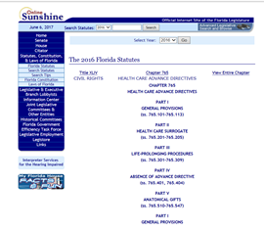
Health Care Surrogate – Suggested Forms
Florida Statute 765.203 – provides a Suggested Designation Form for Health Care Surrogates (adults) Florida Statute 765.2038 – provides a Suggested Designation Form for Health Care Surrogates (minors)

Slide 52
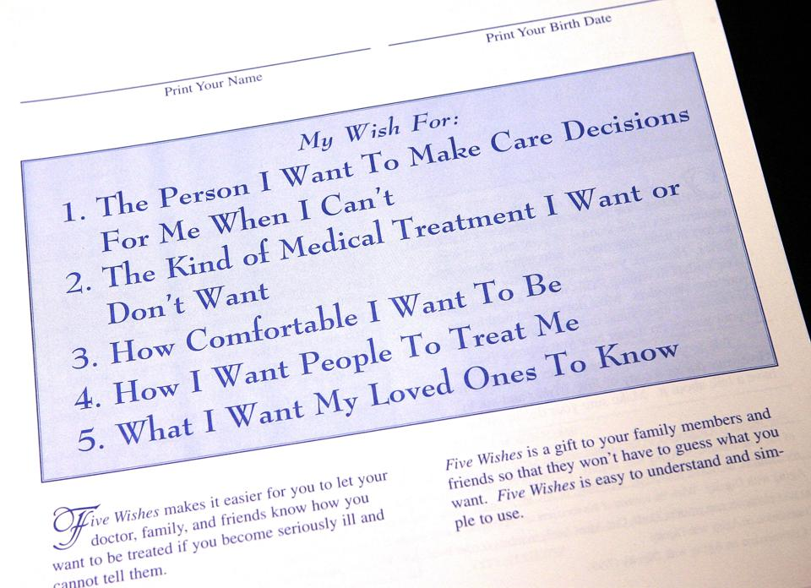
Advance Directive
Requires capacity
Living will
Healthcare Surrogate

Slide 53
Representative Payee
Social Security determines if the individual needs one
Management of SSA benefits
Annual accounting to SSA

Slide 54
Power of Attorney
A Power of Attorney is a legal document that gives someone else the power to act in the place of another person. This means that another person has the authority to carry out activities that they believe the other person would do for themselves. In order for a Power of Attorney to be created, the individual must be able to understand how it can be used and the effect it can have on their property. In Florida, a power of attorney must be signed before two witnesses and a notary public to be considered a legal, binding document.

Slide 55
Powers of Attorney
Gives an adult legal authority to act for another.
Attorney-in-fact
Not responsible for the actions or debts of principal
DPOA
Changes to statute

Slide 56
Durable Power of Attorney
If the individual later becomes incapacitated , the Power of Attorney can be revoked, unless the individual specifically agreed to allow the Power of Attorney to continue after a finding of incapacity. This is known as a Durable Power of Attorney.
A Durable Power of Attorney is a special kind of power of attorney because it remains intact, or “durable,” even if a person suffers mental incapacity in the future. A durable power of attorney can, in additional to handling all financial decisions, authorize medical care. That includes consent to proceed with or terminate all medical and surgical procedures on your behalf, including an agreement that falls under the Life-Prolonging Procedures Act of Florida. Again, a durable power of attorney lets someone act on your behalf if you cannot due to mental incapacity.

Slide 57
Banking Options
Banking Services can also be utilized to assist an individual with managing money. A Joint Bank Account or being a Co-signor on an account and also using Online Banking for Direct Deposits and online bill paying are all examples of banking services that can be utilized to assist and individual who needs support in managing their finances.

Slide 58

Trusts
Trustee holds property/funds for the beneficiary of the trust
Can be person’s own money or given to the trust by the trustee or another.
Special needs trusts designed to prevent assets from impacting receipt of public benefits such as SSI and Medicaid.

Slide 59
Medical Proxy
Person lacks capacity or has DD
Person does not have an advance directive or a medical durable power of attorney
Person needs medical decision-making

Slide 60
Why would we need SDM Agreement when we have POAs and other Alternatives?
The Transference of Power;
“A power of attorney grants another person the authority to make decisions and handle matters without input from the individual. A supported decision-making agreement does not give the supporter the power to make decisions. The person with a disability retains the right to make decisions for himself or herself.”¹

Slide 61
Clear as mud, right?
Capacity is not a fixed concept, a person’s ability to make decisions may change over time.
Less restrictive alternatives are always the first option, and you may have to try more than one.

Slide 62
How We Can Assist
We advocate for the rights and needs of people with disabilities.

Slide 63
2024 Public Input Planning Survey –
Your input matters to us!
Please visit the link below by July 1, 2024 to complete our annual Public Input Planning Survey.
Your responses will help us plan our goals, priorities, and objectives for 2024.
www.DisabilityRightsFlorida.org/Survey

Slide 64

Contact Information
2473 Care Drive, Suite 200
Tallahassee, FL 32308
800.342.0823 • TDD 800.346.4127
www.DisabilityRightsFlorida.org

